Slide 1
Diving Into The Happiness of Each Country
Presentation By: Mustapha Terkmane, Zakarya Louahchi, Kendrick Choong

Slide 2
Research Objective

Slide 3
Research Question & Task Definition
Inspired by the World Happiness Report, our project aims to help analyze trends about happiness in various countries given their attributes such as their social support, life expectancy, population, GDP per capita, etc. Without going into highly complex algorithms and modeling, our goal was to see what insights we could glean from simple data visualization and description to get happiness trends by country.
RQ: How does perceived happiness vary from country to country based on their demographic attributes and which attributes impact happiness the most?

Slide 4
Literature Review

Slide 5
Research Currently Being Conducted
Bodies of Literatures:
International
World Happiness Report
World Database of Happiness
Smaller Scale
Gallup polls
University polling
Psychiatric studies
Discussion:
-Main body of literature discuss happiness from an international standpoint in the WHR (mentioned previously).
-Everything else looks at happiness in a smaller viewpoint like university polling or psychiatric studies trying to delve into what makes people happy on an individual level.

Slide 6
Data Acquisition & Wrangling

Slide 7
Dataset / Variables
The dataset was a combination of Kaggle datasets containing happiness data for a country’s year with a dataset from US Census Bureau on demographical data. This resulted in data from the early 2000’s to 2023 for 145 countries.
Sources:
Kaggle Author Ajaypal Singh
WHR 2021
WHR 2022
WHR 2023
US Census International DB
List of Country 2 Digit Code
Variables:
Happiness Score
Year
Population
Country
GDP Per Capita
Social Support
Full Census IDB Variable List

Slide 8
Variable Name | Description
Happiness Score | A nationally representative average of individuals rating their own lives on a 0 to 10 scale with 0 being the absolute worst life they could have and 10 being the absolute best life they could have.
Population | The midyear population counts for a specific country.
Healthy Life Expectancy | Healthy life expectancies at birth are based on the data extracted from the World Health Organization’s (WHO) Global Health Observatory data repository (Last updated: 2020-12-04).
GDP Per Capita | The statistics of GDP per capita (variable name gdp) in purchasing power parity (PPP) at constant 2017 international dollar prices are from World Development Indicators.
Social Support | The national average of the binary responses to the question “If you were in trouble, do you have relatives or friends you can count on to help you whenever you need them, or not?”
Table of Important Variable Descriptions

Slide 9
Data Cleaning Process
Cleaning Steps:
Delineate txt data
Derive country code
Limit years to 2000-2023
Mean imputation of missing values.
WHR 2021 File
WHR 2022 File
Census File
Census DF
WHR 2023 File
Merging Steps:
Left merge Census DF w/ country CD DF to make New Census DF
Inner join WHR with New Census DF on Country & Year to create Final DF
Drop unnecessary columns from merge
Country CD File
Country CD DF
Cleaning Steps:
Read in data to DFs
Drop unnecessary columns
Rename/add columns to match
Append all DFs together
Final DF
Contains:
Happiness Data
Demographic Data
WHR DF

Slide 10
Analysis

Slide 11
Descriptive Statistics
 | Ladder Score | Logged GDP per Capita | Social Support | Healthy Life Expectancy
Mean | 5.51 | 9.40 | 0.82 | 63.67
Std | 1.14 | 1.12 | 0.12 | 7.56
Min | 2.38 | 6.64 | 0.29 | 32.30
Max | 8.02 | 11.65 | 0.99 | 77.1
25% | 4.64 | 8.46 | 0.75 | 58.97
50% | 5.44 | 9.54 | 0.85 | 65.5
75% | 6.38 | 10.41 | 0.91 | 69.0
Number of Variables: 122
Number of Records: 1837
Countries: 145
Date Range: 2005 - 2021

Slide 12
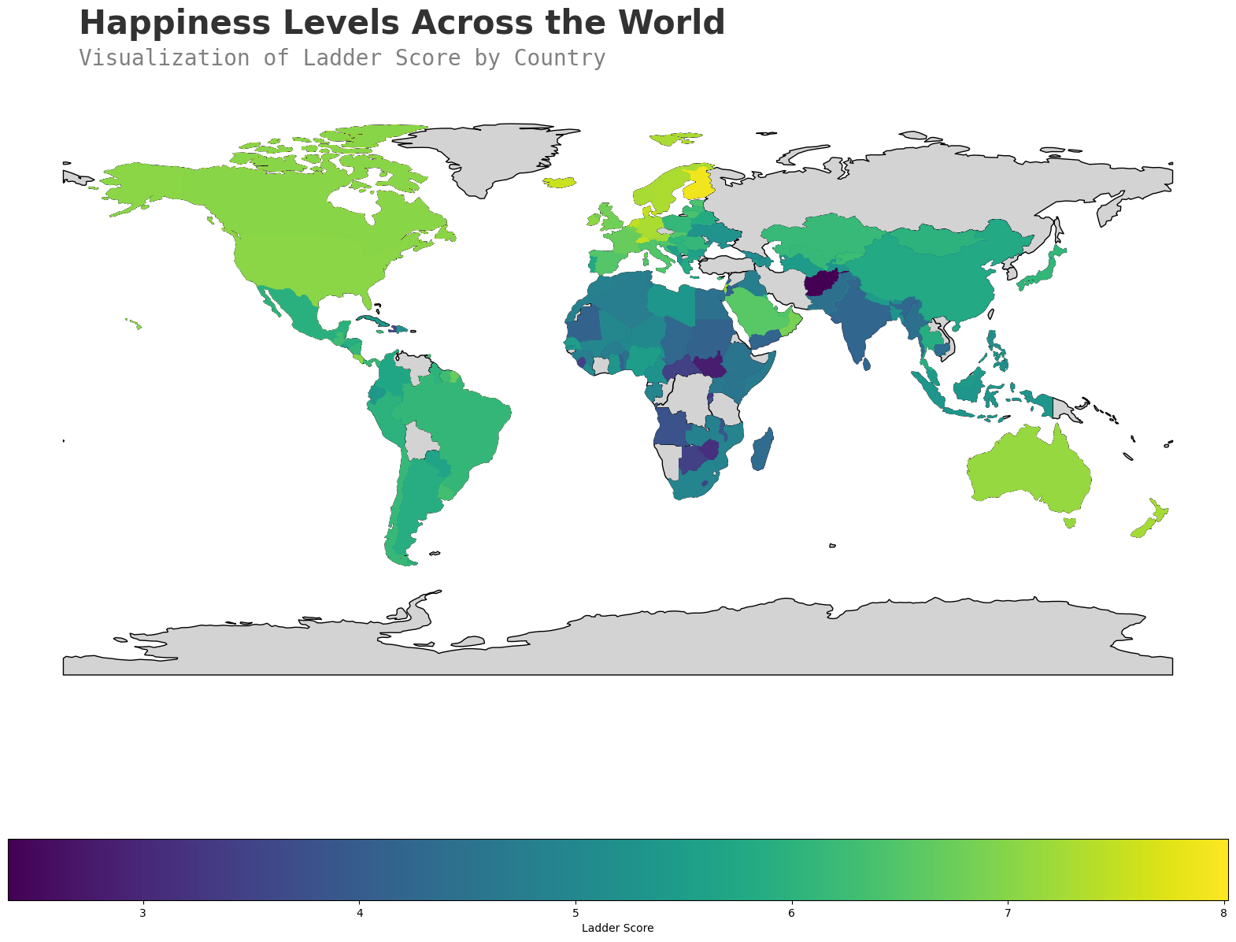
Visual Analysis 1
- Graphing the happiness by country in a geographical way helps identify which regions are happiest vs not.
- We see that the happiest regions are in North America and Europe with some of the unhappiest countries residing in Africa.

Slide 13
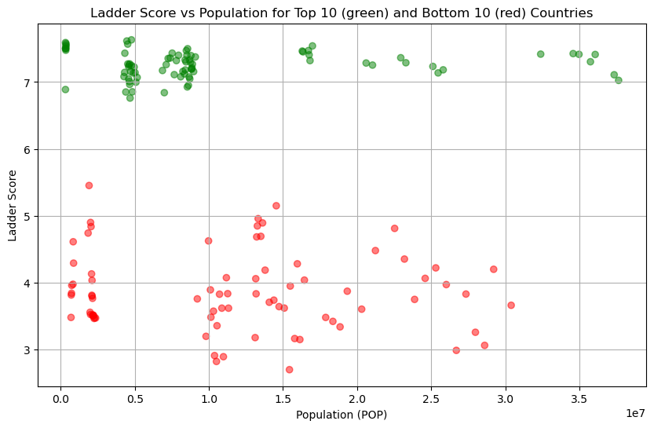
Visual Analysis 2
- It doesn’t seem like population and happiness are 100% correlated.
- Having more or less people could lead to issues of overcrowding, but we see many countries that are equally happy with more and less people.

Slide 14
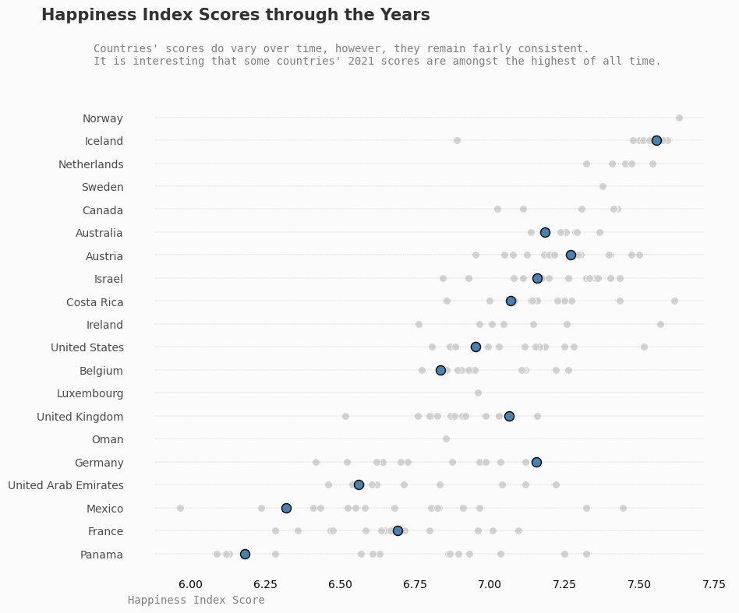
Visual Analysis 3
- Not every country is consistently happy year over year like Iceland.
- Some countries have had much happier years and much sadder years in the dataset.
- For some countries, 2021 was a relatively good year and for some it was on the lower end of their band.

Slide 15
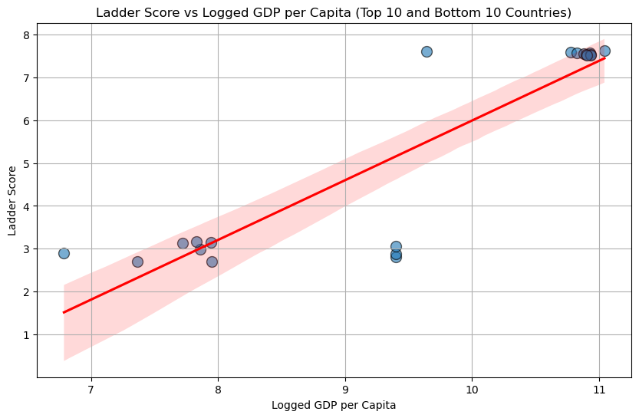
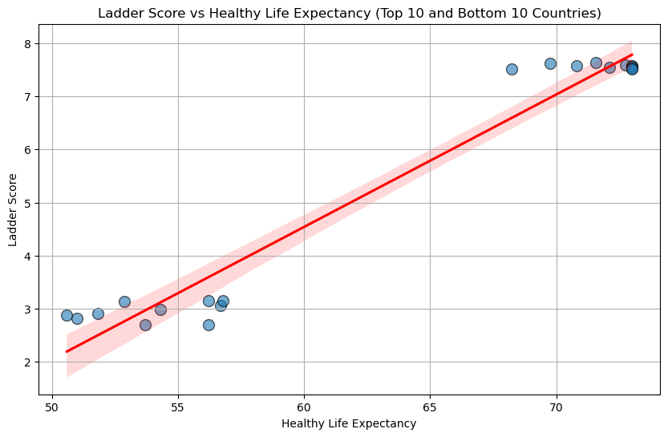
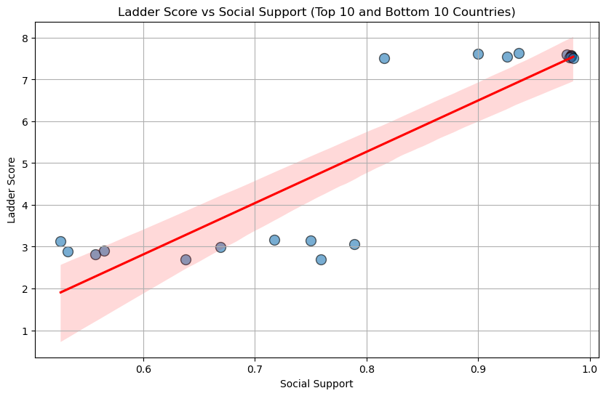
Visual Analysis 4
- For the most part, the more quality of life aspects a country has the happier it is.
- GDP per capita and Healthy Life Expectancy is tightly grouped compared to Social Support. So even if a country has higher perceived social support, it might still not be overall happier.

Slide 16
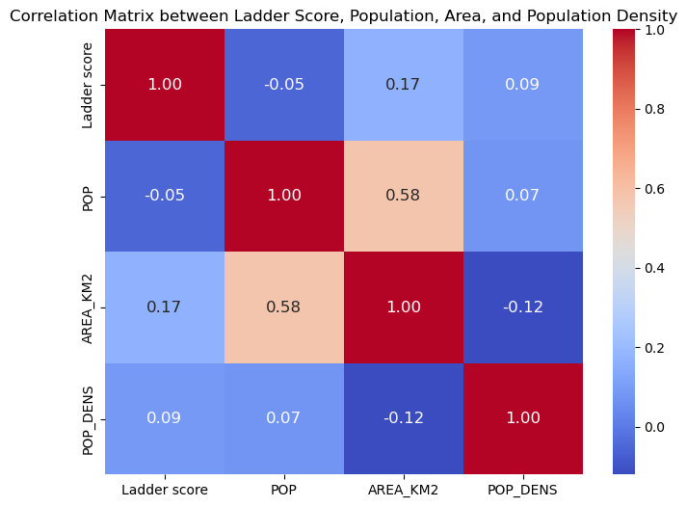
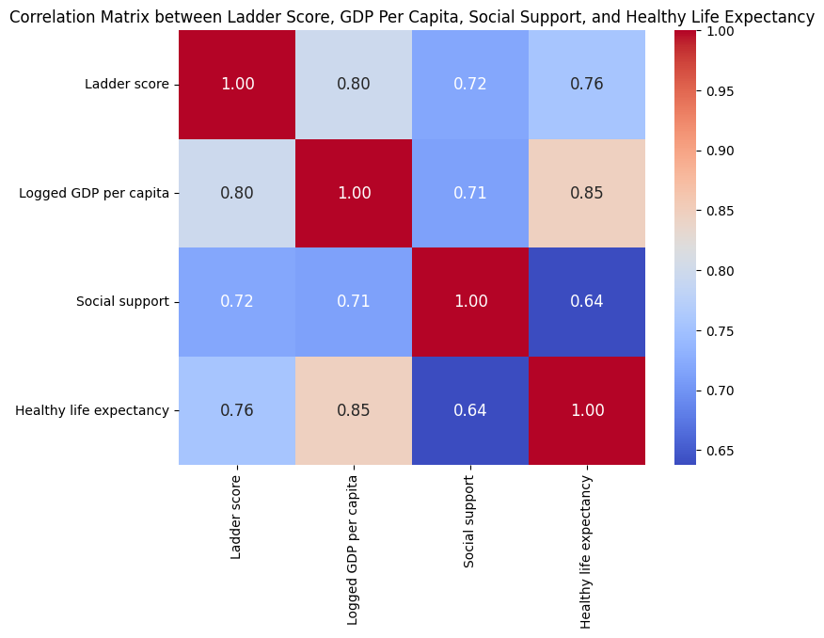
Visual Analysis 5
- Going back to population, there doesn’t seem to be any strong correlation between the ladder score and the number of people in a country. - There is more positive correlation between other aspects of a country in relation to the ladder score such as the GDP, the social support, etc.

Slide 17
Statistical Analysis: Multiple Linear Regression
Q: Why Multiple Linear Regression?
To quantify the relationship between GDP, social support, healthy life expectancy, and happiness
To determine and compare the influence of each factor on happiness
To test the significance of each predictor and their contributions

Slide 18
Statistical Analysis: Multiple Linear Regression
Key findings
Higher GDP per capita is associated with higher happiness
Strong social support greatly enhances happiness
Longer healthy life expectancy boosts happiness.
P-values < 0.0001, indicating high statistical significance.
Variable | Coeff | P-val
Logged GDP per capita | 0.3693 | <0.0001
Social Support | 2.7211 | <0.0001
Healthy Life Expectancy | 0.0383 | <0.0001

Slide 19
Conclusion(s)
Some quality of life aspects in a country seem to correlate positively with happiness such as life expectancy, GDP per capita, and social support.
Other demographics like population or anything related to the land mass of a country has little correlation with the reported happiness.
Some countries have consistently been happy whereas other countries fluctuate in being happier or sadder over the years.

Slide 20
Questions?

